Slide 1


Notes:
GOOD EVENING EVERYONE BEFORE I START MY FIRST PRESENTATION FOR DUE50032 COMMUNICATICATIVE ENGLISH 3 LET ME INTRODROUS MYSELF .MY NAME IS CKC MATICS NUMBER IS 03DET22F1043 FROM CLASS DET4C MY LACTURE IS NUR HARTINI BINTI HARUN .

Slide 2

Notes:
THE TITLE OF OUR GROUP IS CAR INDUSTRIAL WORLDWIDE.

Slide 3
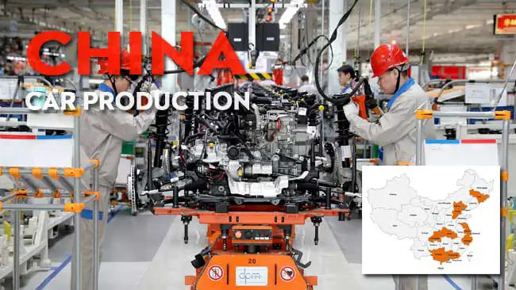
Notes:
FOR ME ,I AM CHOOSE THE CAR INDUSTRI IN CHINA .BECAUSE I THINK Today, China‘s car industry ranks among the best in the world. SO TODAY LET US Come and learn about China’s car industry

Slide 4
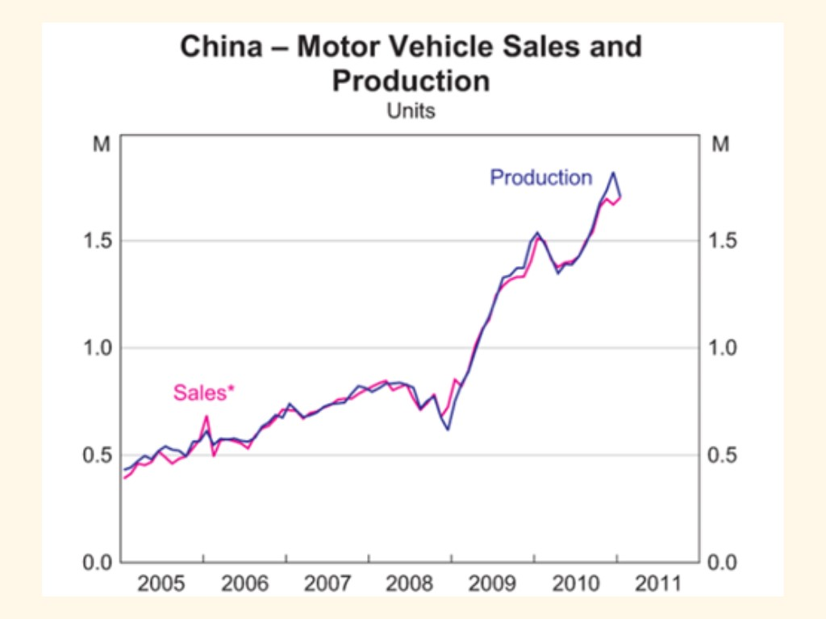
Notes:
In this line graphs, is perfect to show about motor vehicle sales and production in china. In this graph we can see when 2005 to 2008 the sales and production is increase steadily. But when after 2008 motor vehicle sales and production in china will increase sharply.At 2010 breakthrough 1.5m per year, SO I THINK It will also grow year..by year in the future.

Slide 5
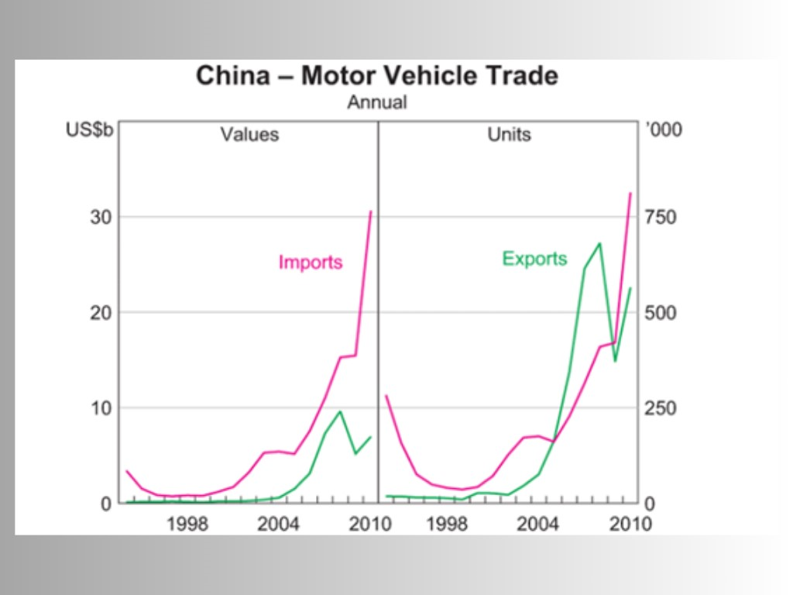
Notes:
AFTER THAT From this chart, we can know that after 2004, China began to export its own vehicles on a large SCARE. Although the value of Chinese-made vehicles is not high and they cannot be sold for very high prices TO OTHER countries, their prices are rising steadily. Although China still relied heavily on imported cars from 1998 to 2010, this is because foreign countries had already produced their own car brands before the 1990s(NINETEEN NINETY YEAR), and China only began to rise after the 1990s. Now Chinese car compOMY are (STURKELING) to catch up.

Slide 6
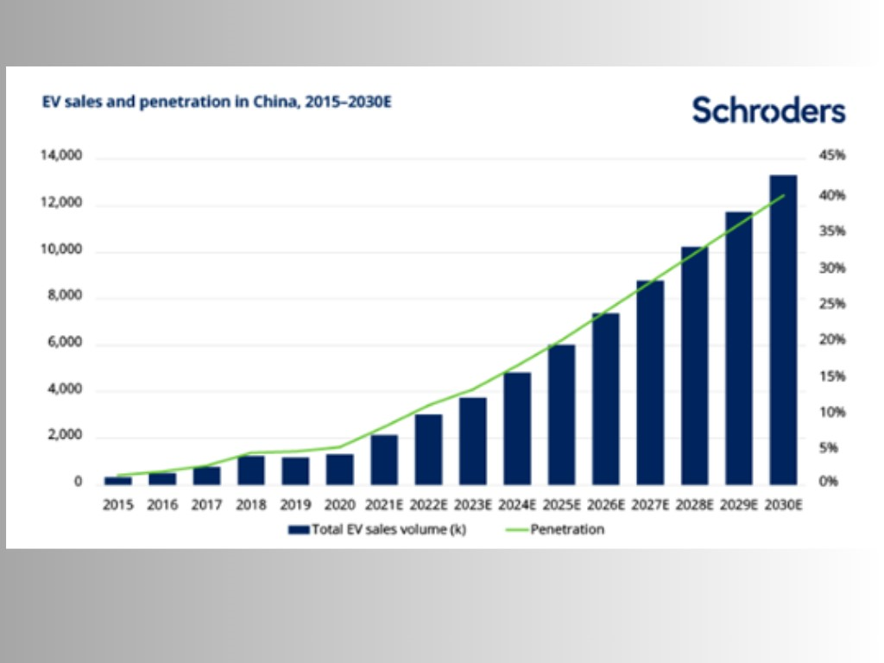
Notes:
in this graph we can know the ev car sales and penetration when 2015 to 2030 in china. Sales are rising steadily every year so we can know the ev car in china are very popular. Nearly 4,000 electric vehicles will be sold in 2023 alone. Experts predict that sales of electric vehicles in China will exceed 1.2m units in 2030. Electric cars are the future, so I think what we are reading about electricity will be of great use in the future.

Slide 7

Notes:
THIS IS END OF MY PRESENTTATION I WILL PAST TO MY NEXT GROUPMEMBER TO PRESENT THEIR SLIDE .THANKYOU

